Slide 1


Clustering Analysis US Stock Return Correlation
Group 3 - 2021 April 3

Slide 2

1
Data Downloading
2
Stock Correlation Clustering Analysis
3
Stock Correlation Asset Allocation
Contents
4
Result Analysis
5
Further Study and References

Slide 3
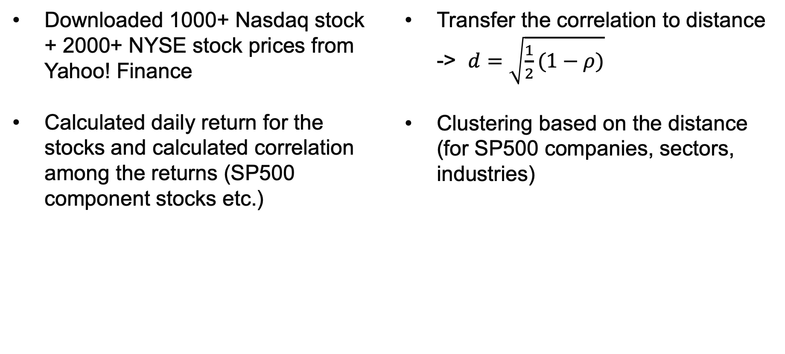
Steps
Downloaded 1000+ Nasdaq stock + 2000+ NYSE stock prices from Yahoo! Finance
Calculated daily return for the stocks and calculated correlation among the returns (SP500 component stocks etc.)
Transfer the correlation to distance -> $d=\sqrt{\frac{1}{2}(1−ρ)}$
Clustering based on the distance (for SP500 companies, sectors, industries)
Clustering Analysis - Data Downloading 3

Slide 4
Data Downloading
Prepared symbol list file (tickers of small, mid, large, mega cap companies) (Nasdaq 1358, NYSE 2061)
Use downloading script to get historical price data from Yahoo! Finance (time interval from 2011-03-16 to 2021-03-16)
Use concurrency: futures.ThreadPoolExecutor with max 4 workers -> slightly faster
Took around 30 minutes to download the data set
Alternatively, you can use the shared data set here: https://drive.google.com/file/d/1Uy0VmrkbKUAskGKAAQo45F8unrphAF14/view?usp=sharing
Clustering Analysis - Data Downloading 4

Slide 5
Data Downloading
def download_one(symbol):
if os.path.exists(FILEDIR + '{}.csv'.format(symbol)):
# logging.info('already downloaded, skip')
return
logging.info('downloading for symbol: {}'.format(symbol))
try:
abc = downloader.downloader(symbol,start,end)
abc = abc.decode(‘utf-8')
with open(FILEDIR + '{}.csv'.format(symbol), "w") as f:
f.writelines(str(abc))
logging.info('downloaded successfully')
except:
logging.error('got error when trying to download: {}'.format(symbol))
def download_many(symbols: list[str]) -> None:
with futures.ThreadPoolExecutor(max_workers=4) as executor:
res = executor.map(download_one, symbols)
def main():
logging.info('start downloading process...')
nasdaq_symbols = read_symbols('nasdaq_symbols.csv')
nyse_symbols = read_symbols('nyse_symbols.csv')
symbols = nasdaq_symbols + nyse_symbols
download_many(symbols)
logging.info('finished downloading process!')
Clustering Analysis - Data Downloading 5

Slide 6
Data Downloading
Code: downloader.py （https://stackoverflow.com/questions/44030983/yahoo-finance-url-not-working）
import requests
import re
import json
import time as time
def run(symbol, initial, final):
start = int(time.mktime(time.strptime(str(initial), '%Y-%m-%d')))
end = int(time.mktime(time.strptime(str(final), '%Y-%m-%d')))
abc = downloader(symbol,start,end)
abc = abc.decode('utf-8')
with open('{}.csv'.format(symbol), "w") as f:
f.writelines(str(abc))
def downloader(symbol, start, end):
ses = requests.session()
resp = ses.get(
f'https://finance.yahoo.com/quote/{symbol}/history?period1={start}&period2={end}&interval=1d&filter=history&frequency=1d'
)
resp.raise_for_status()
data = resp.content.decode('utf-8')
crumb_m = re.search(r'"CrumbStore":\{"crumb":("[^"]+")\}', data)
assert crumb_m
crumb = json.loads(crumb_m.group(1))
csvresp = ses.get(
f'https://query1.finance.yahoo.com/v7/finance/download/{symbol}?period1={start}&period2={end}&interval=1d&events=history&crumb={crumb}'
)
csvresp.raise_for_status()
return csvresp.content
Clustering Analysis - Data Downloading 6

Slide 7
Data Downloading
Code: auto_download.py
import time
import logging
import downloader
import os
import argparse
from concurrent import futures
FILEDIR = os.path.join('downloaded_data', 'data')
initial = '2011-3-16'
final = '2021-3-16'
formatter = '%(asctime)s - %(name)s - %(levelname)s - %(message)s'
logging.basicConfig(filename='auto_download.log', filemode='w', level=logging.INFO, format=formatter)
parser = argparse.ArgumentParser()
parser.add_argument("-i", "--initial", help="initial date in %Y-%m-%d format")
parser.add_argument("-f", "--final", help="final date in %Y-%m-%d format")
args = parser.parse_args()
if args.initial:
initial = args.initial
if args.final:
final = args.final
logging.info('date range: from {} to {}'.format(initial, final))
start = int(time.mktime(time.strptime(str(initial), '%Y-%m-%d')))
end = int(time.mktime(time.strptime(str(final), '%Y-%m-%d')))
if not os.path.exists(FILEDIR):
os.makedirs(FILEDIR)
def read_symbols(symfile):
syms = []
with open(symfile, 'r') as f:
content = f.readlines()
for s in content:
syms.append(s.strip())
return syms
def download_one(symbol):
if os.path.exists(FILEDIR + '{}.csv'.format(symbol)):
# logging.info('already downloaded, skip')
return
logging.info('downloading for symbol: {}'.format(symbol))
try:
abc = downloader.downloader(symbol,start,end)
abc = abc.decode('utf-8')
with open(FILEDIR + '{}.csv'.format(symbol), "w") as f:
f.writelines(str(abc))
logging.info('downloaded successfully')
except:
logging.error('got error when trying to download: {}'.format(symbol))
def download_many(symbols: list[str]) -> None:
with futures.ThreadPoolExecutor(max_workers=4) as executor:
res = executor.map(download_one, symbols)
def main():
logging.info('start downloading process...')
nasdaq_symbols = read_symbols('nasdaq_symbols.csv')
nyse_symbols = read_symbols('nyse_symbols.csv')
symbols = nasdaq_symbols + nyse_symbols
download_many(symbols)
logging.info('finished downloading process!')
if __name__ == '__main__':
main()
Clustering Analysis - Data Downloading 7

Slide 8
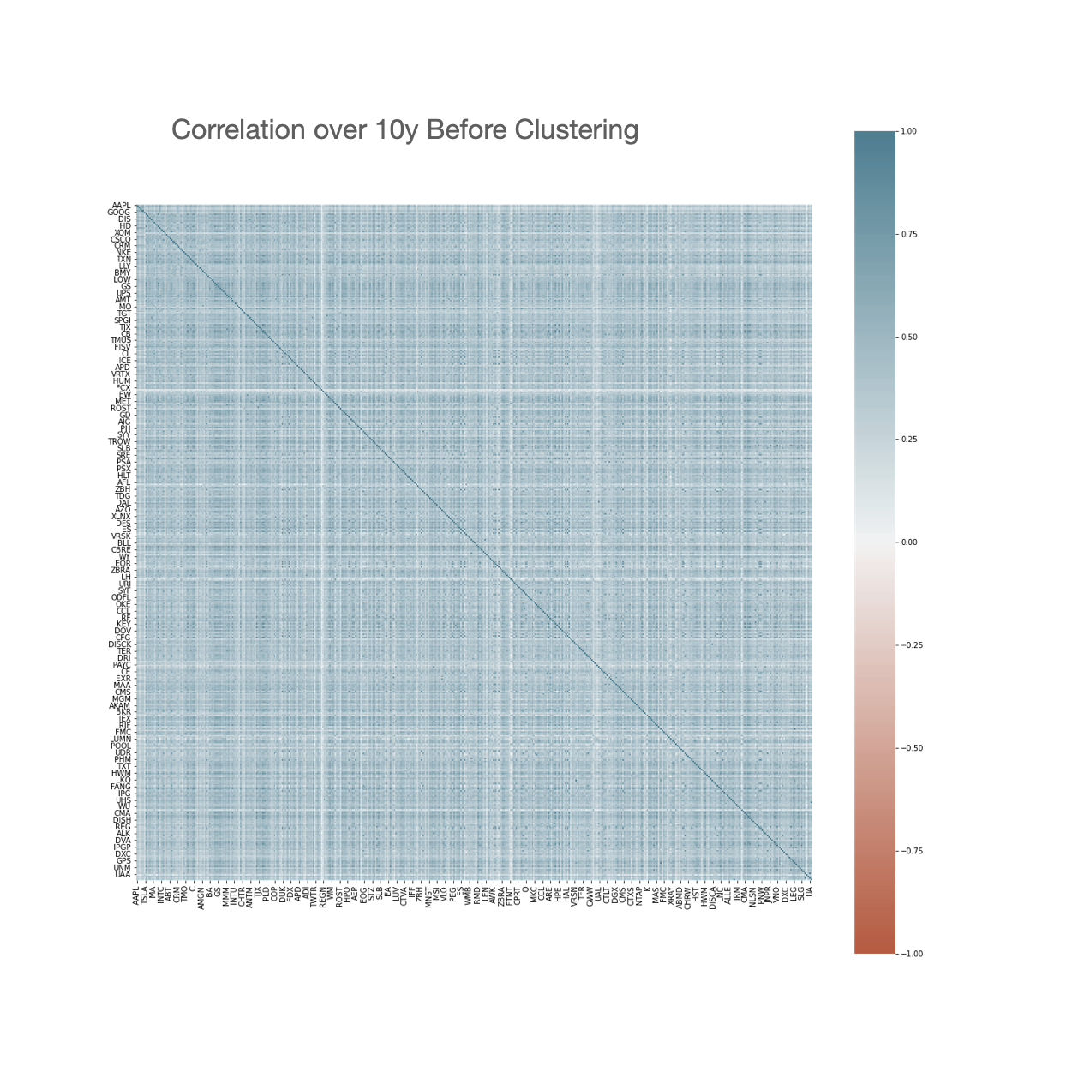
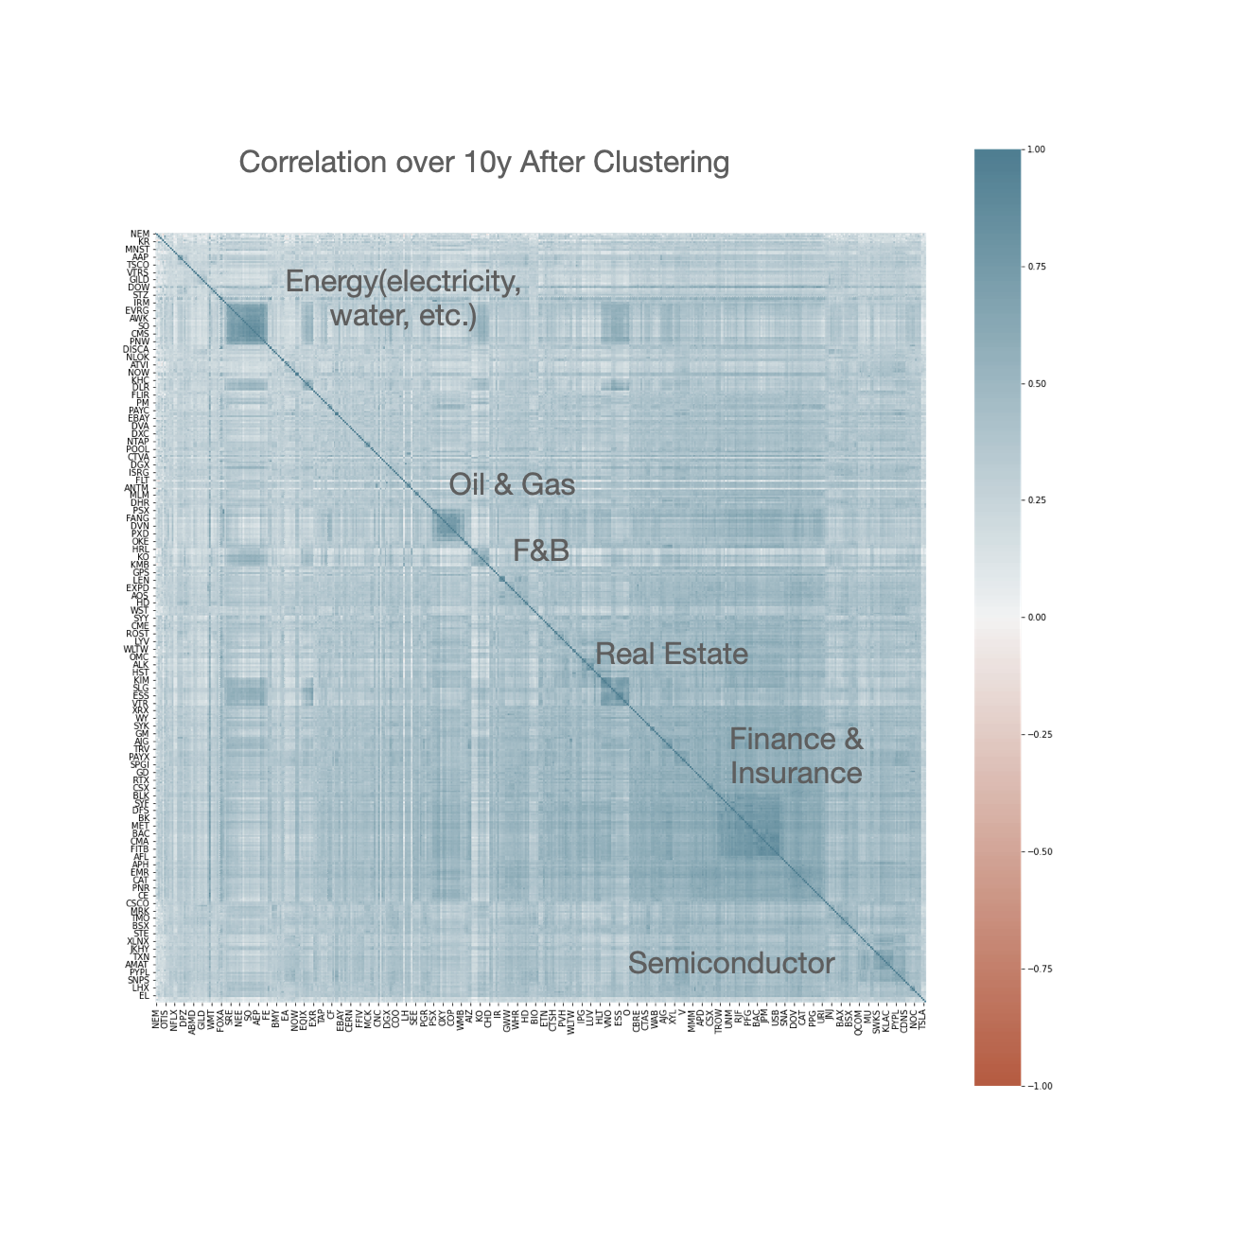
S&P500 Correlation
Clustering Analysis – Stock Correlation Clustering 8

Slide 9
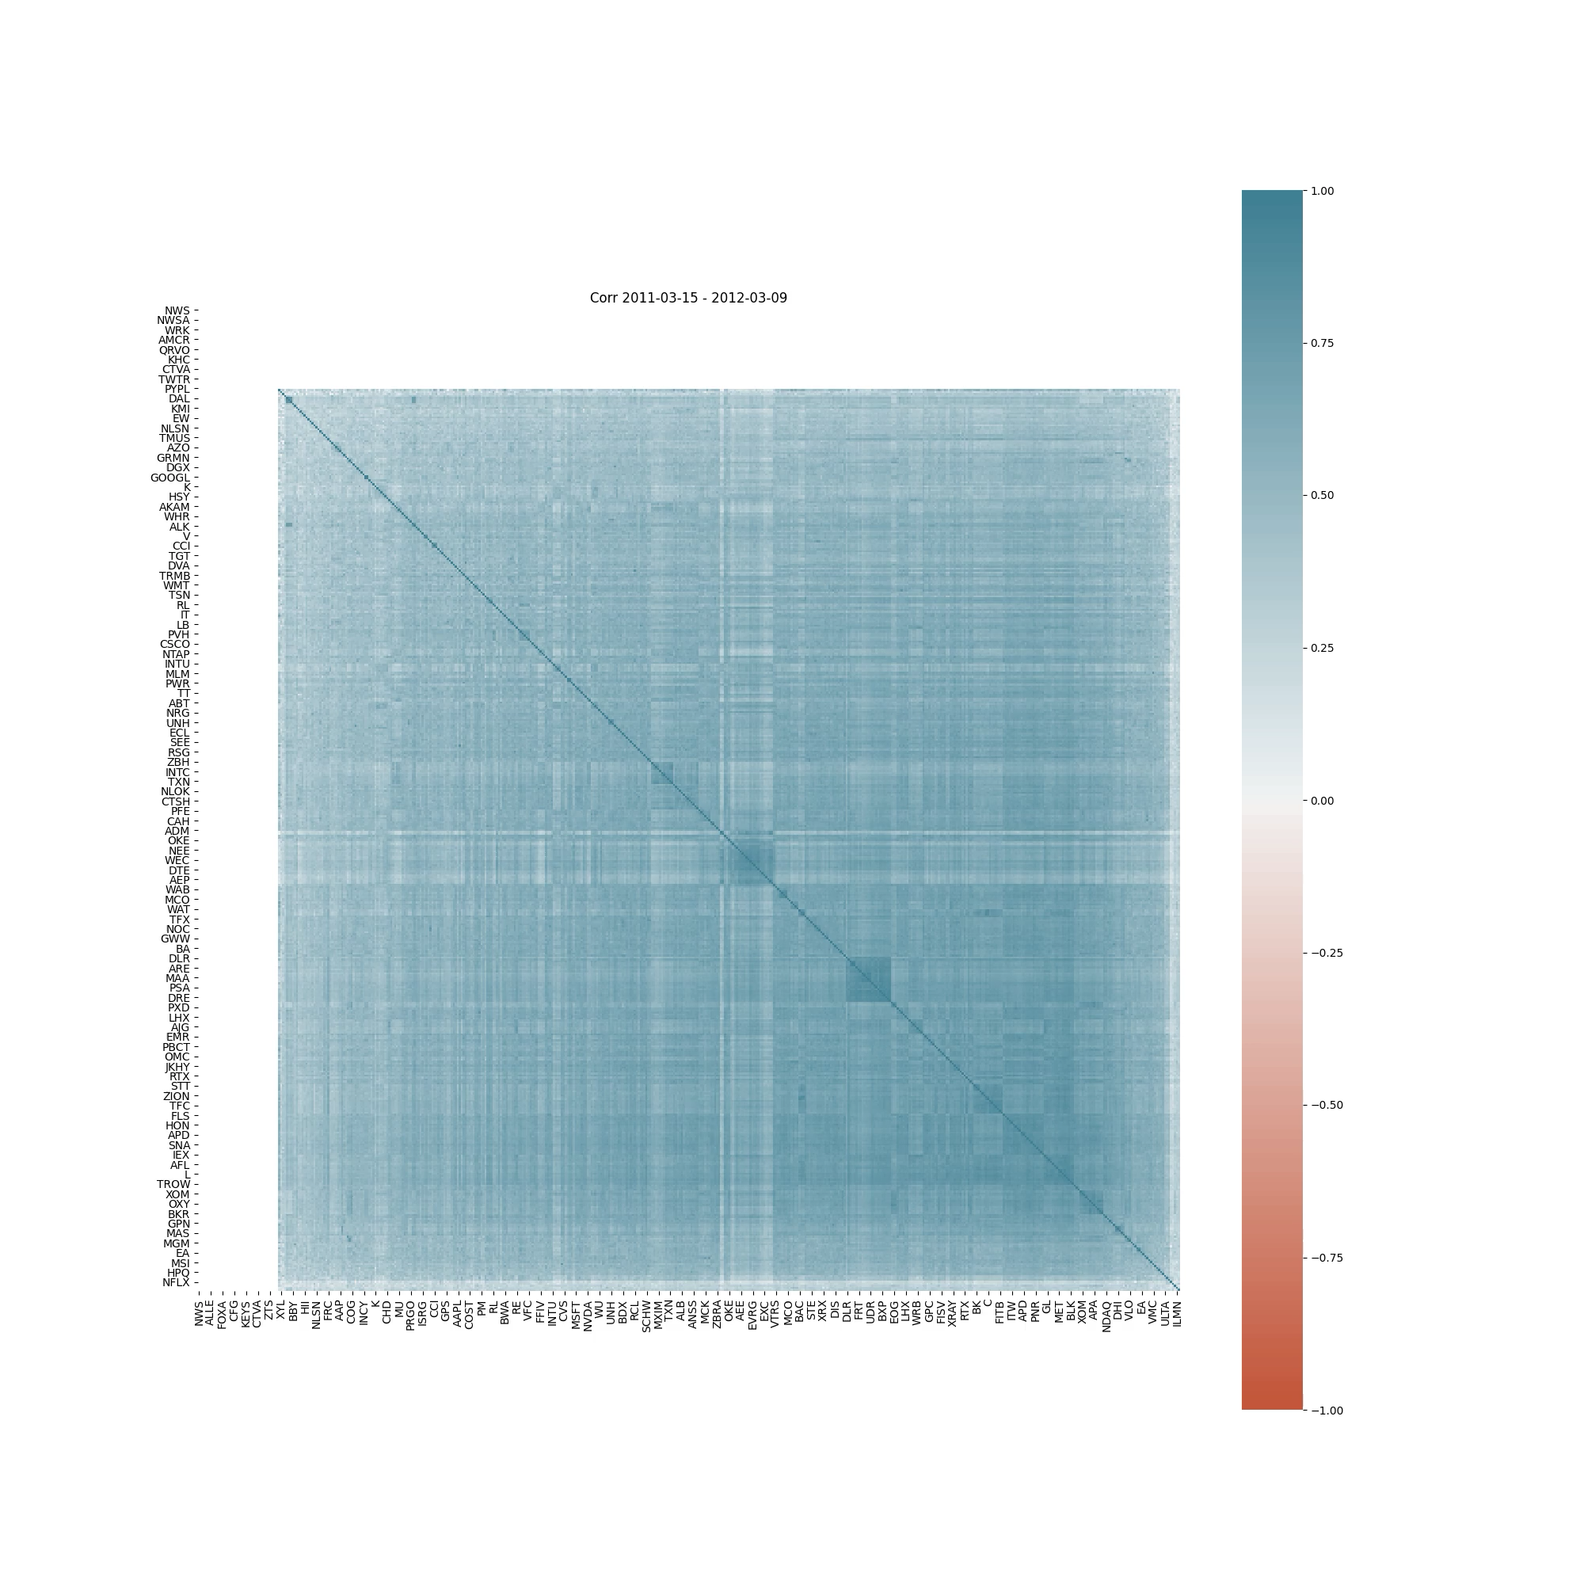
S&P500 Correlation Clustering
Time Window = 1y
Period from 2011 Mar to 2021 Mar, calculate 1y correlation every 90 days
Correlations among stock returns are lower during normal periods, but becomes high during financial crisis
Future work: we can rolling with other time windows such as 3m, 6m, 9m, 1y, 1.25y, 1.5y, 2y, etc., and check the result
Clustering Analysis – Stock Correlation Clustering 9

Slide 10

Sectors
basic industries
capital goods
consumer durables
consumer nondurables
consumer services
energy
finance
health care
public utilities
technology
transportation
miscellaneous
Clustering Analysis – Stock Correlation Clustering 10

Slide 11
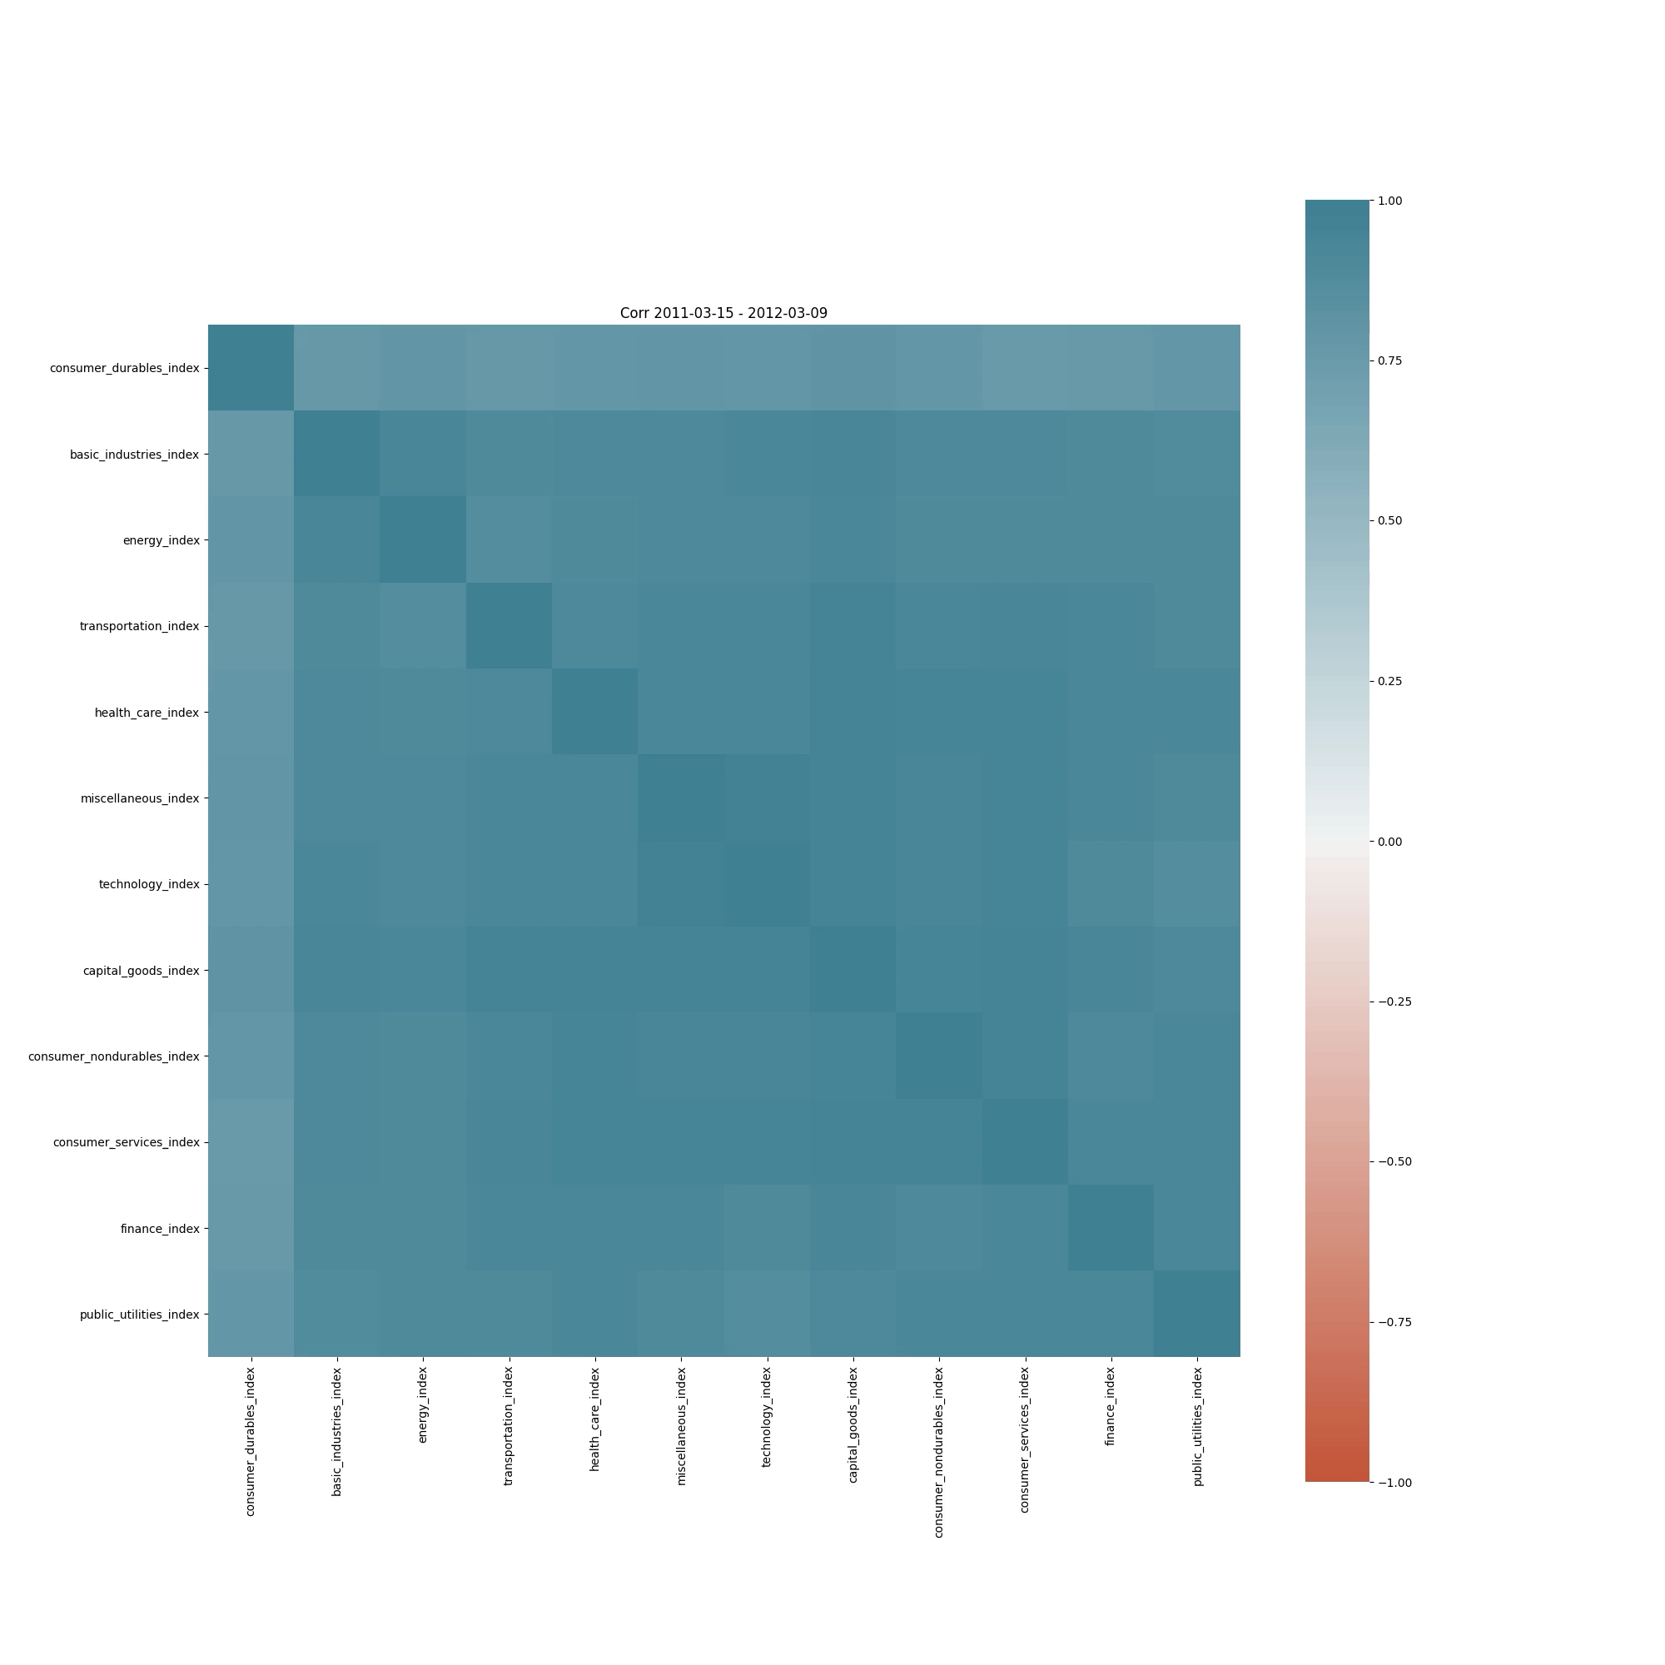
Correlation among Sectors
Time Window = 1y
Period from 2011 Mar to 2021 Mar, calculate 1y correlation every 90 days
Sectors consumer service and consumer durables have relatively lower correlation with others in year 2017
Generally correlations are relatively high among sectors, especially during financial crisis
Clustering Analysis – Stock Correlation Clustering 11

Slide 12
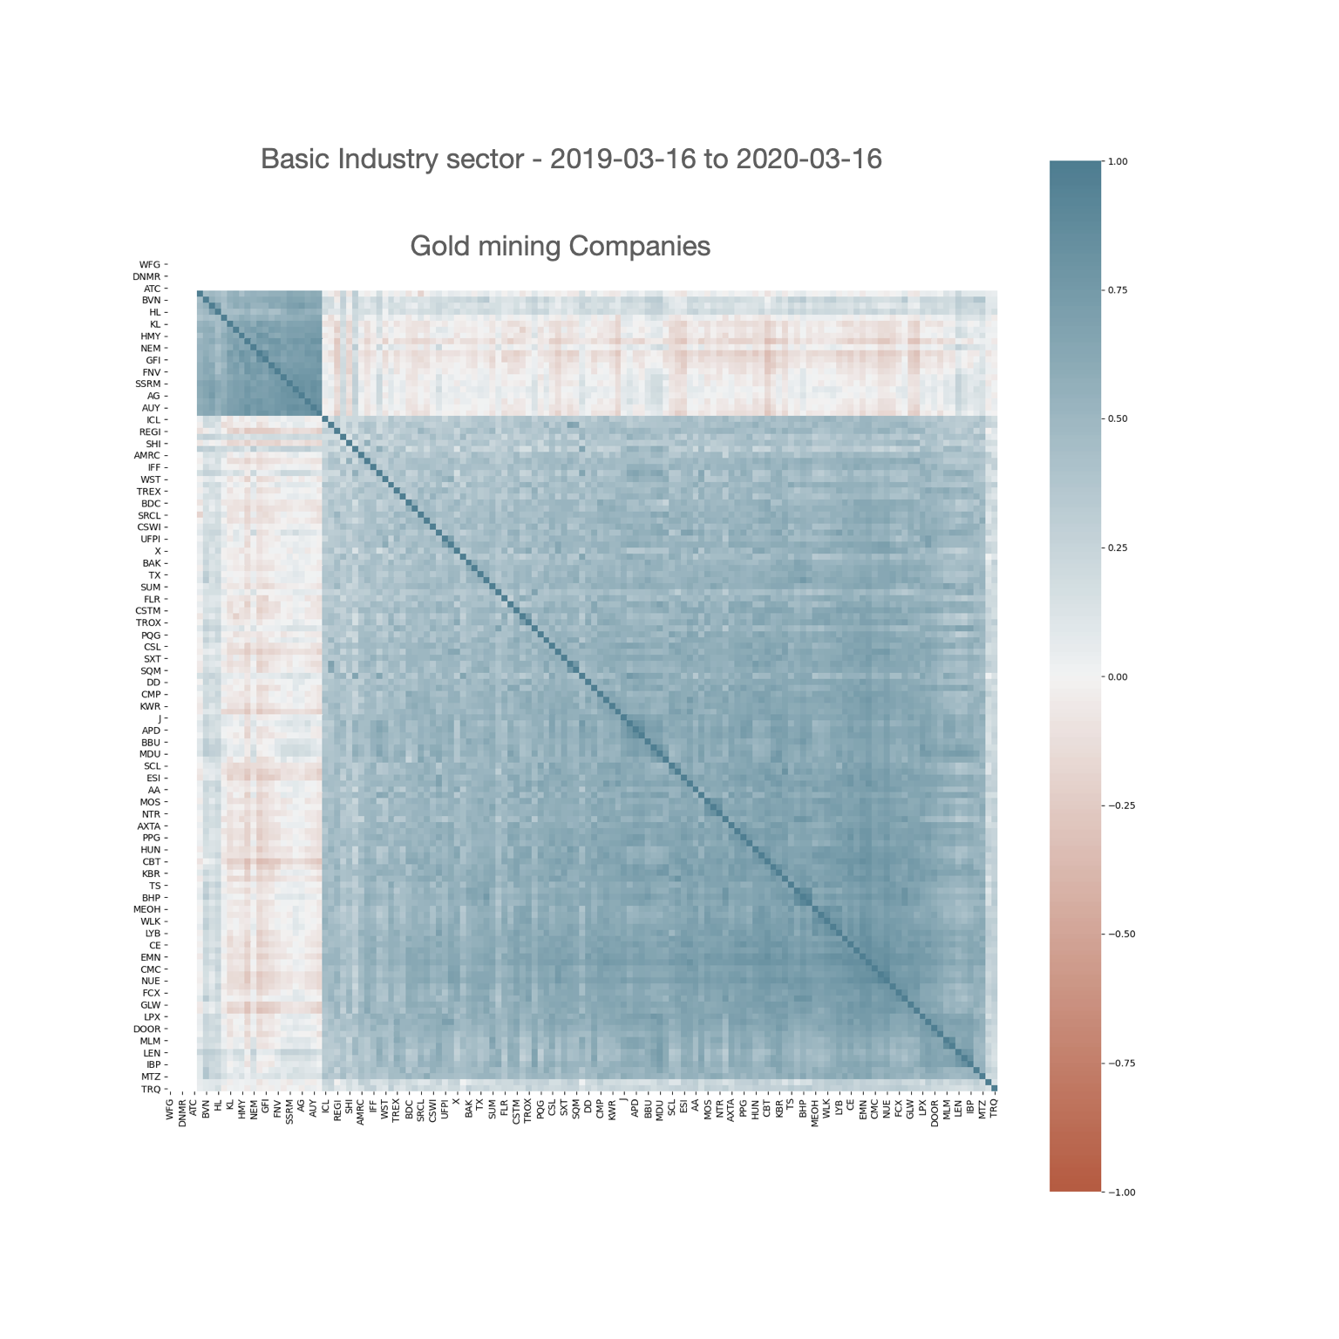
Correlation within Sector
Time Window = 1y
During financial crisis, the stock returns of gold mining companies are negatively correlated with stock returns of others
Clustering Analysis – Stock Correlation Clustering 12

Slide 13
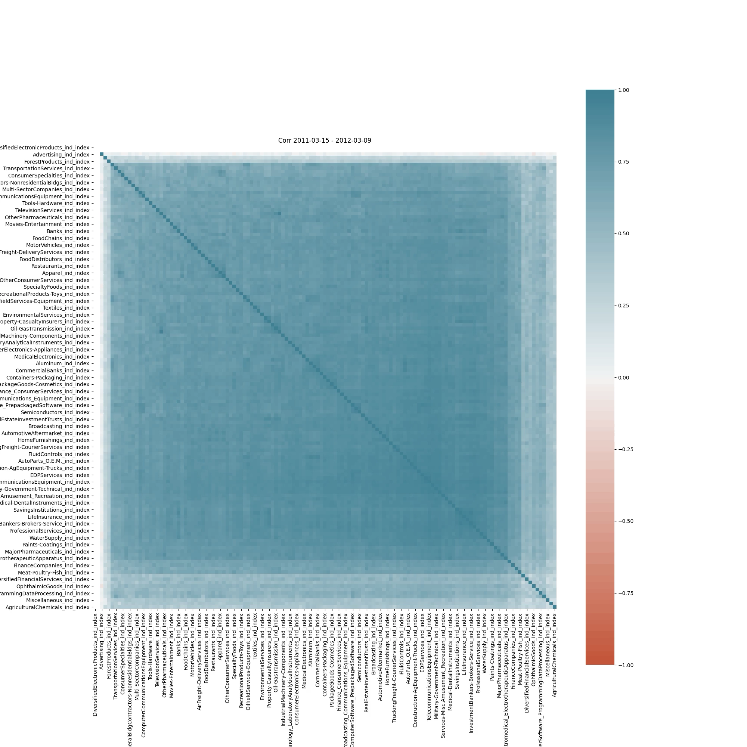
Industries
Time Window = 1y
Period from 2011 Mar to 2021 Mar, calculate 1y correlation every 90 days
Sectors consumer service and consumer durables have relatively lower correlation with others in year 2017
Generally correlations are relatively high among sectors, especially during financial crisis
Future work: we can rolling with other time windows such as 3m, 6m, 9m, 1y, 1.25y, 1.5y, 2y, etc., and check the result
Clustering Analysis – Stock Correlation Clustering 13

Slide 14
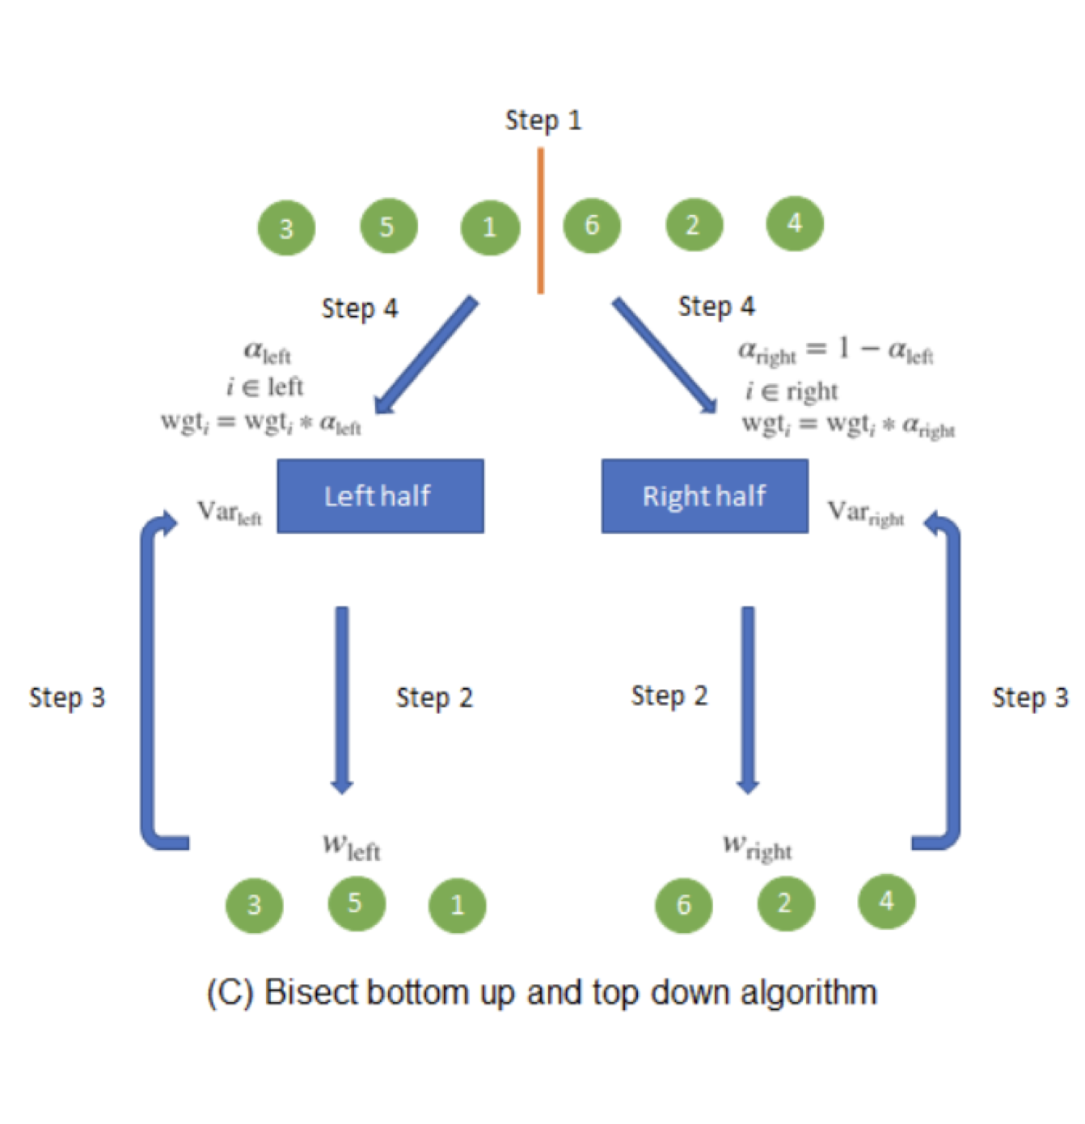

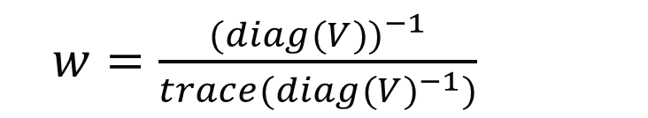
HRP (hierarchical risk parity)
$w=\frac{(diag({V))}^{−1}}{{trace(diag(V)}^{−1})}$
$$\tilde{V}= w^{′}Vw$$
$$α_{left}=1−\frac{{\tilde{V}}_{left}}{{\tilde{V}}_{left}+{\tilde{V}}_{right}}$$
$$α_{right}=1−α_{left}$$
Clustering Analysis – Stock Correlation Asset Allocation 14

Slide 15
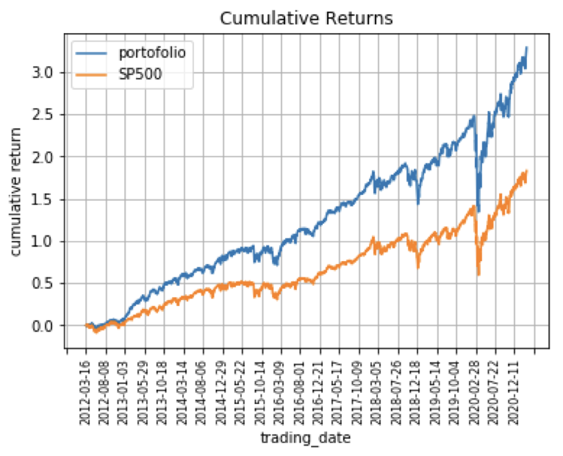
Backtest Result
We use HRP method to compute daily weight of stock in SP500 with the past 252 days stock return.
It is a long only strategy since the weight is all positive.
 | Performance
IC | 0.0048
IR | 0.0231
annual_return | 0.1902
Sharpe | 1.2309
Maxdrawdown | 1.1372
Clustering Analysis – Stock Correlation Asset Allocation 15

Slide 16
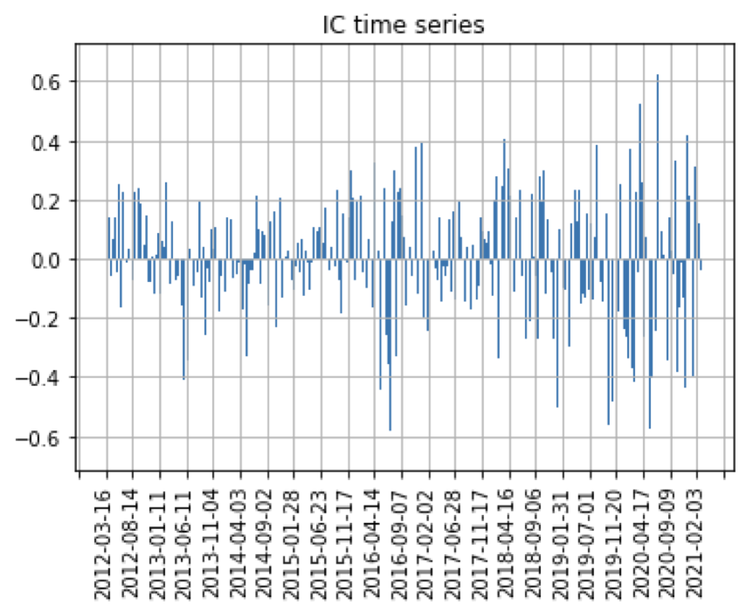
Result Analysis
Average IC = 0.005
IR = 0.023
It has relative strong signal
but not stable
Clustering Analysis – Result Analysis 16

Slide 17
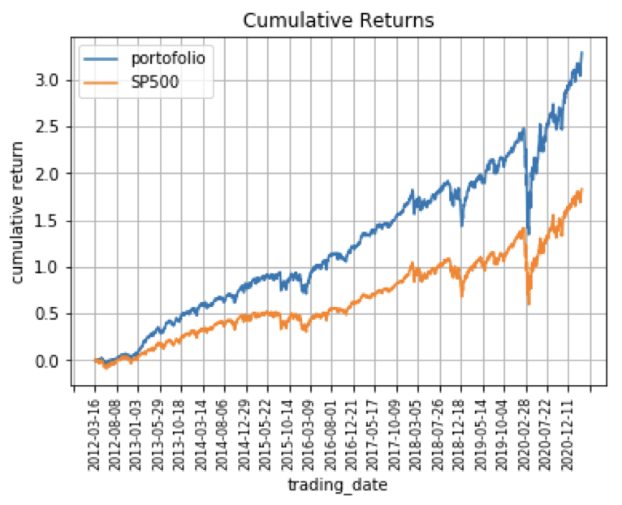
Result Analysis
It can beat SP500 index in the past 8 years especially in the bull market.
It has larger drawdown than SP500 in bear market like the beginning of 2020.
Clustering Analysis – Result Analysis 17

Slide 18
Further Study
HRP doesn’t use the hierarchical clustering information sufficiently. It only use the sorted order of clustering data.
It means this method is not exactly risk parity, e.g. our backtest of SP500 stocks.
HCRP model use the covariance of assets, which can better weight assets with high correlation.
Clustering Analysis – Further Study and References 18

Slide 19
References
Marcos Lopez de Prado (2018): Advances in Financial Machine Learning. Wiley.
Michaud, R. (1998): Efficient Asset Allocation: A Practical Guide to Stock Portfolio Optimization and Asset Allocation, 1st ed. Harvard Business School Press.
Ledoit, O. and M. Wolf (2003): “Improved estimation of the covariance matrix of stock returns with an application to portfolio selection.” Journal of Empirical Finance, Vol. 10, No. 5, pp. 603–621.
Raffinot, T. (2017): “Hierarchical clustering based asset allocation.” Journal of Portfolio Management
Rokach, L. and O. Maimon (2005): “Clustering methods,” in Rokach, L. and O. Maimon, eds., Data Mining and Knowledge Discovery Handbook. Springer, pp. 321–352.
https://stackoverflow.com/questions/44030983/yahoo-finance-url-not-working
Thanks for listening!
Clustering Analysis – Further Study and References 19

